Slide 1

Route Combination Performance
2021 Sports Info Solutions Analytics Challenge
Taylor Williams

Slide 2
Agenda
Opportunity Statement
Target Area Grouping
Route Combination Clustering
Cluster Performance
Future Work
Conclusion

Slide 3
Opportunity Statement
On any play in the NFL there are 5 skill position players that can potentially be running a route
There are multiple strategic purposes for the routes that are run:
To be thrown to
To clear space or occupy defenders for a teammate to be thrown to
To stay in for blocking
The goal of this analysis was to determine the popular combinations of routes called in 2020 and assess their effectiveness against various defensive coverage schemes

Slide 4
Target Area Grouping
With 50 different routes listed, we needed to generalize similar routes into higher level categories
Routes were grouped according to which sector of the field the route started from and intended to get to – called the Target Area
The Target Areas were defined as:
Backfield
Crossing
Deep Middle
Short Middle
Deep Outside
Short Outside
Non-Routes

Slide 5
Target Area Grouping Continued
LOS
~10 yds
Offense ->
Short Outside:
Check & Release (L+R)
Chip (Curl + Flat)
Comeback
Curl (L+R)
Flat
Jerk
Deep Outside:
Chip (Seam)
Corner
Corner Post
Fade
Go/Fly
Backfield:
Beneath
Jet Sweep
Quick
Screen
Short Middle:
Angle
Check & Release (M)
Chip (Drag)
Curl (M)
Over Ball
Run Fake (M)
Crossing:
Deep Cross
Dig
Drag
Leak
Slant
Deep Middle:
Post
Seam
Sluggo
Stick - Nod
Short Outside:
Out
Pick
Run Fake (L+R)
Swing
Whip
Non-Route:
Blocking
NULL
Deep Outside:
Hitch & Go
Out & Up
Post Corner
Wheel

Slide 6
Route Combination Clustering
On a per-play level, the number of each Target Area routes were counted
Running plays were included, but spikes and kneels were excluded
K-Means clustering was used to group plays based on the similar combinations of players in Target Areas
The 4 cluster solution proved to be the most appropriate for the set of data

Slide 7
Route Combination Clustering Results
Cluster 1 is the variety play with focus over the middle. It’s far more likely to have Backfield, Deep Outside, Deep Middle, and Short Middle routes
Cluster 2 is the crossing route play. It will send 2 players in crossing routes with another on the outside running short or deep
Cluster 3 is the non-route play. Almost all 5 skill players are not running routes. These are almost exclusively run plays
Cluster 4 is the short area play. It will have 2 or 3 players running short routes on the outside as well as one in the short middle and/or deep outside
 |  | Cluster
 |  | 1 | 2 | 3 | 4
Target Areas | Backfield | 0.271 | 0.040 | 0.150 | 0.038
 | Crossing | 0.605 | 2.289 | 0.036 | 0.499
 | DeepMiddle | 0.561 | 0.256 | 0.004 | 0.294
 | DeepOutside | 1.107 | 0.636 | 0.021 | 0.618
 | ShortMiddle | 0.844 | 0.429 | 0.036 | 0.672
 | ShortOutside | 0.683 | 0.948 | 0.047 | 2.518
 | NonRoute | 0.795 | 0.357 | 4.492 | 0.312

Slide 8
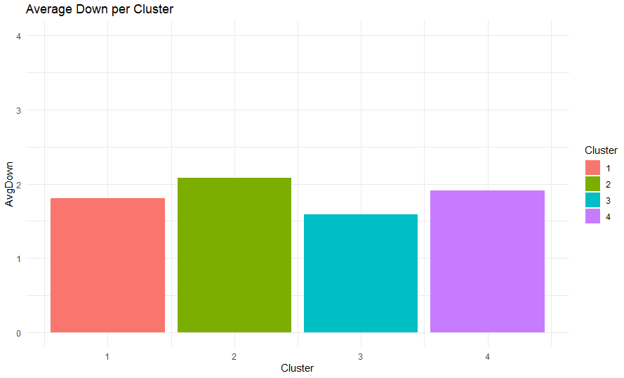
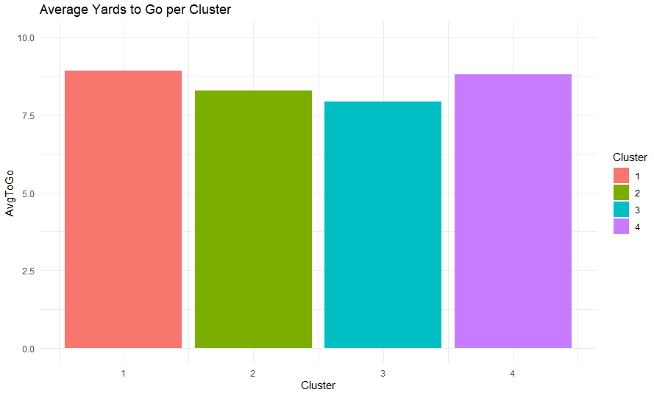
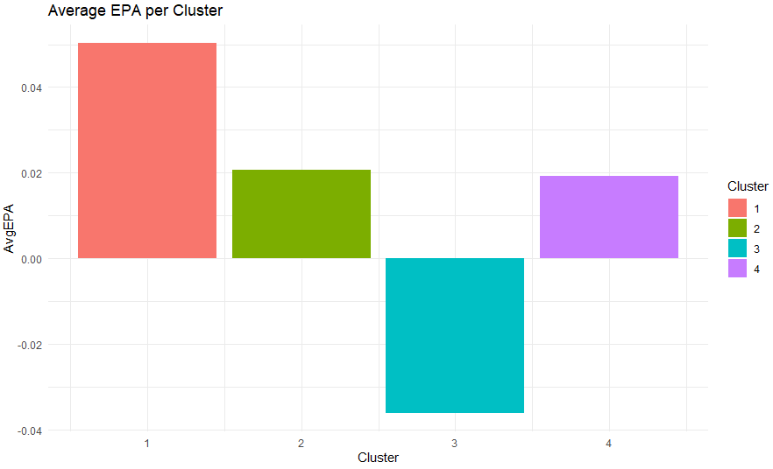
Cluster Performance
Cluster 1 overall is the most successful. Cluster 3 is the only negative EPA call
Clusters 2 and 4 tend to come on later downs
Cluster 3 typically has the fewest yards to go even though it happens on the earliest down. Suggests run plays are called on first down and then only when near the first

Slide 9
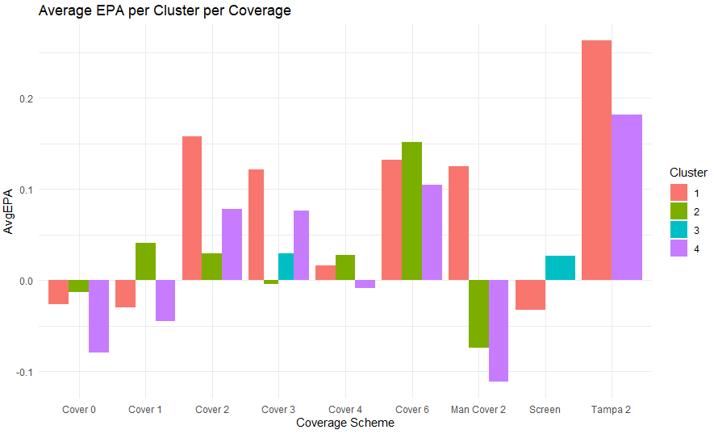
Cluster Performance Continued
Considering only pass plays, clusters can be compared against coverage schemes (with 100 plays minimum)
Cluster 1 shines against Cover 2, Man Cover 2, and Tampa 2. With a variety of routes throughout the field, it’s not surprising it is effective at punishing defenses trying to send 2 defenders deep
Cluster 2 performs best against Cover 1 and Cover 6. The crossing routes prove to be man beaters in the case of little help in the middle (Cover 1) or when each side of the field is its own coverage unit (Cover 6)
Cluster 4 lines up similarly to Cluster 1 but never does as well. The short outside route combination is more conservative so inherently won’t put up the same gaudy EPA totals
At 90+% rush rate, Cluster 3 often doesn’t have a large enough passing sample against specific coverage types though it does prove to be effective against a screen defense suggesting that even when the defense knows what’s coming (lots of blocking for screens), it still works

Slide 10
Future Work
Much more can be done to analyze the performance of route combinations
One area would be to differentiate between the left and right sides of the field for the Target Area definitions, rather than just grouping as outside
I didn’t consider the importance of which route was targeted on a play. Perhaps in certain combinations there is a specific route that is much more effective to target than the others
I compared how the clusters did across all plays in various metrics (EPA, success rate, yards) but didn’t model the expected performance based on situation to assess how the clusters perform relative to a baseline expectation

Slide 11
Conclusion
By grouping routes into Target Areas based on where the route started and finished, plays can be described by the number of skill players in each Target Area
Using those totals, plays can be clustered to determine similar combinations of routes utilized on plays
I found that often plays had two crossing routes and a short outside route (Cluster 2), three short outside routes (Cluster 4), two deep routes, a short outside route, and a backfield route (Cluster 1), or five non-routes on runs and screens (Cluster 3)
Each cluster performs better from an EPA perspective against different coverage schemes. Crossing routes against Cover 1, a variety against Cover 2, and short outside routes against Tampa 2

